Slide 1
Deploying a distributed AD DS environment

Slide 2
Executive summary
Purpose
Layout
Style
The executive summary should be a brief, stand-alone version of a document that focuses on the most important messages, meant to be read rather than presented.
Do not include any content that is not in the body of the document.
Use the columns in this layout to organize the content.
If you need more than 3 columns, use two rows or add a second page.
Be brief. Write the shortest, simplest sentences possible.
Favor active over passive verbs.
Use plain words and the client’s terminology, not consulting jargon.
Source: …

Slide 3
Agenda
Updates to the template
PowerPoint tips

Slide 4




Slide titles should be one or two lines – for longer titles and additional layout options, right click the slide and select ‘Layout’
Use subtitles to add context (they are now slightly smaller to avoid crowding)
New guidelines for color
New guidelines for bullets
New guidelines for font size
Use color strategically to direct attention to content by using icons, color in charts, and contrast layouts.
Use the new electric blue icons (examples above) to add colorful visual entry points to your document.
And use images from our TeamSlide Image Library to establish rhythm in your presentation.
Manage bullet clutter by following these rules of thumb:
Consider applying bullets to lists with more than three items
Use bullets when you need to express hierarchy
Introduce a bulleted list with a sentence or phrase
For shorter lists, use text without bullets, properly spaced, like the lists on this page.
Use a font size of 16 points or more for a presentation.
Use a font size of 12 points only for a pre-read or leave-behind document.
A font size of 10 points can be used for callouts or dense tables.
Notes:
4

Slide 5
Agenda
Updates to the template
PowerPoint tips

Slide 6

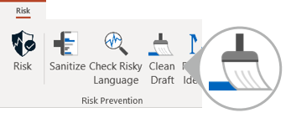

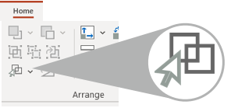

1
FORMAT UPDATER
2
CLEAN DRAFT
Spend less of your day in PowerPoint with these time-saving tips
When pasting a slide
When it’s time to clean up your pages
Clean up formatting and make content fit in one click with the Format Updater
Save time with the automatic Clean Draft tool
3
SELECT SIMILAR
See over two dozen more time-saving tips on the PowerPoint pages of the GHD website
When formatting similar objects
Click on one and use Select Similar to select the rest at once

